Slide 1
Inventory Management System
Names of People

Slide 2
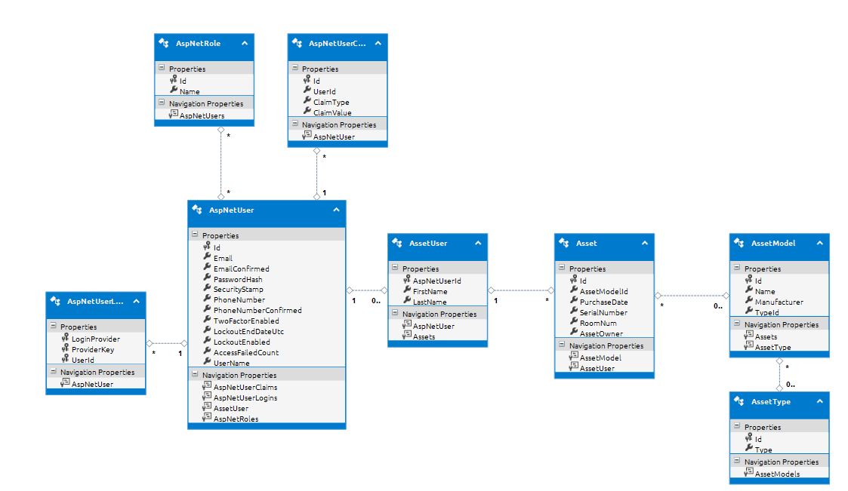
Class Model/EDMX

Slide 3
Asset Search

Slide 4
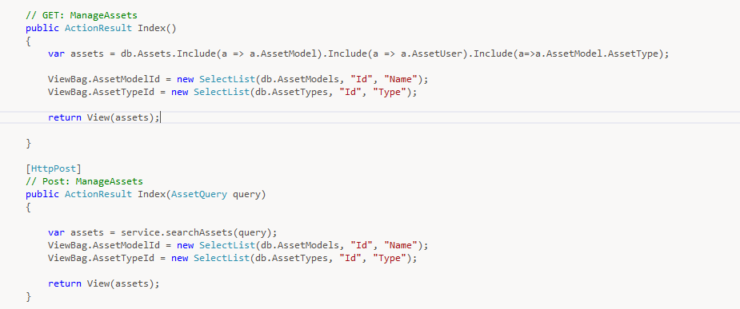
Controller

Slide 5
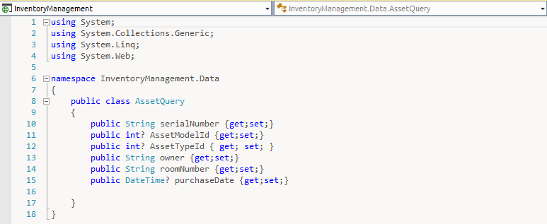
Query Class

Slide 6
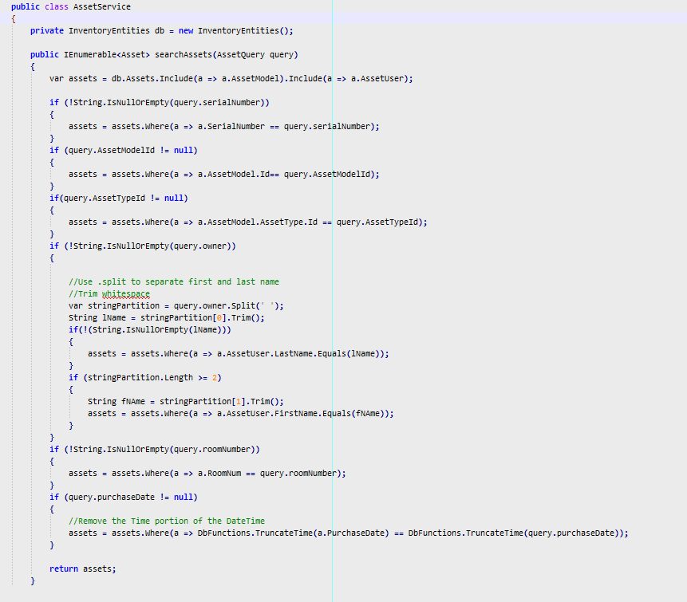
Search Logic

Slide 7

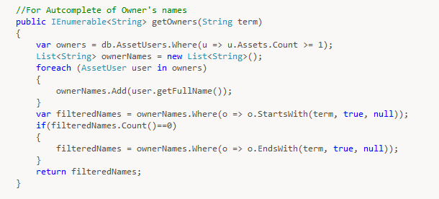
Autocomplete

Slide 8
Edit

Slide 9
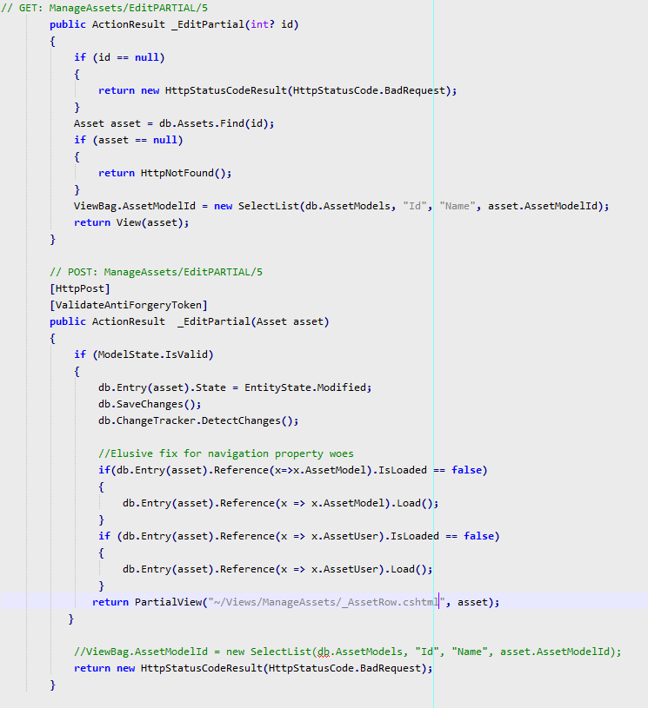
Controller

Slide 10
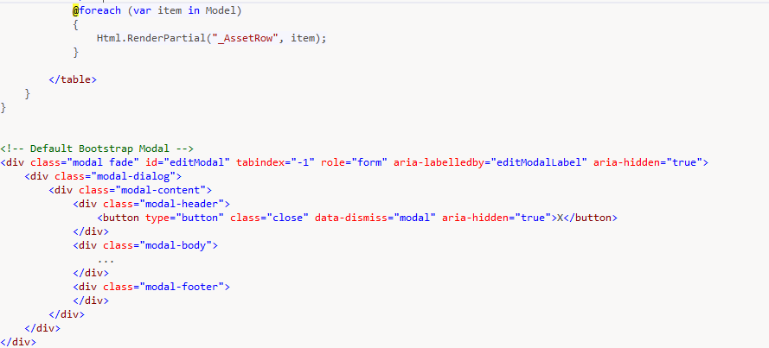

View – Partial Rows & Modal

Slide 11
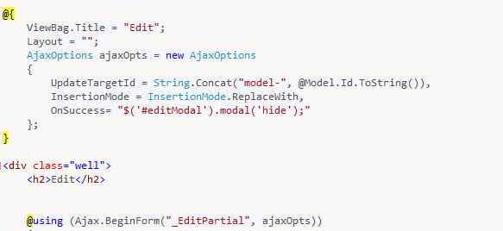
Ajax Form

